Slide 1
DevOps

Slide 2

Agenda
Why DevOps ?
Define DevOps ?
Dev Vs Ops
What does DevOps actually mean ?
Automation
Building blocks of devops ?

Slide 3
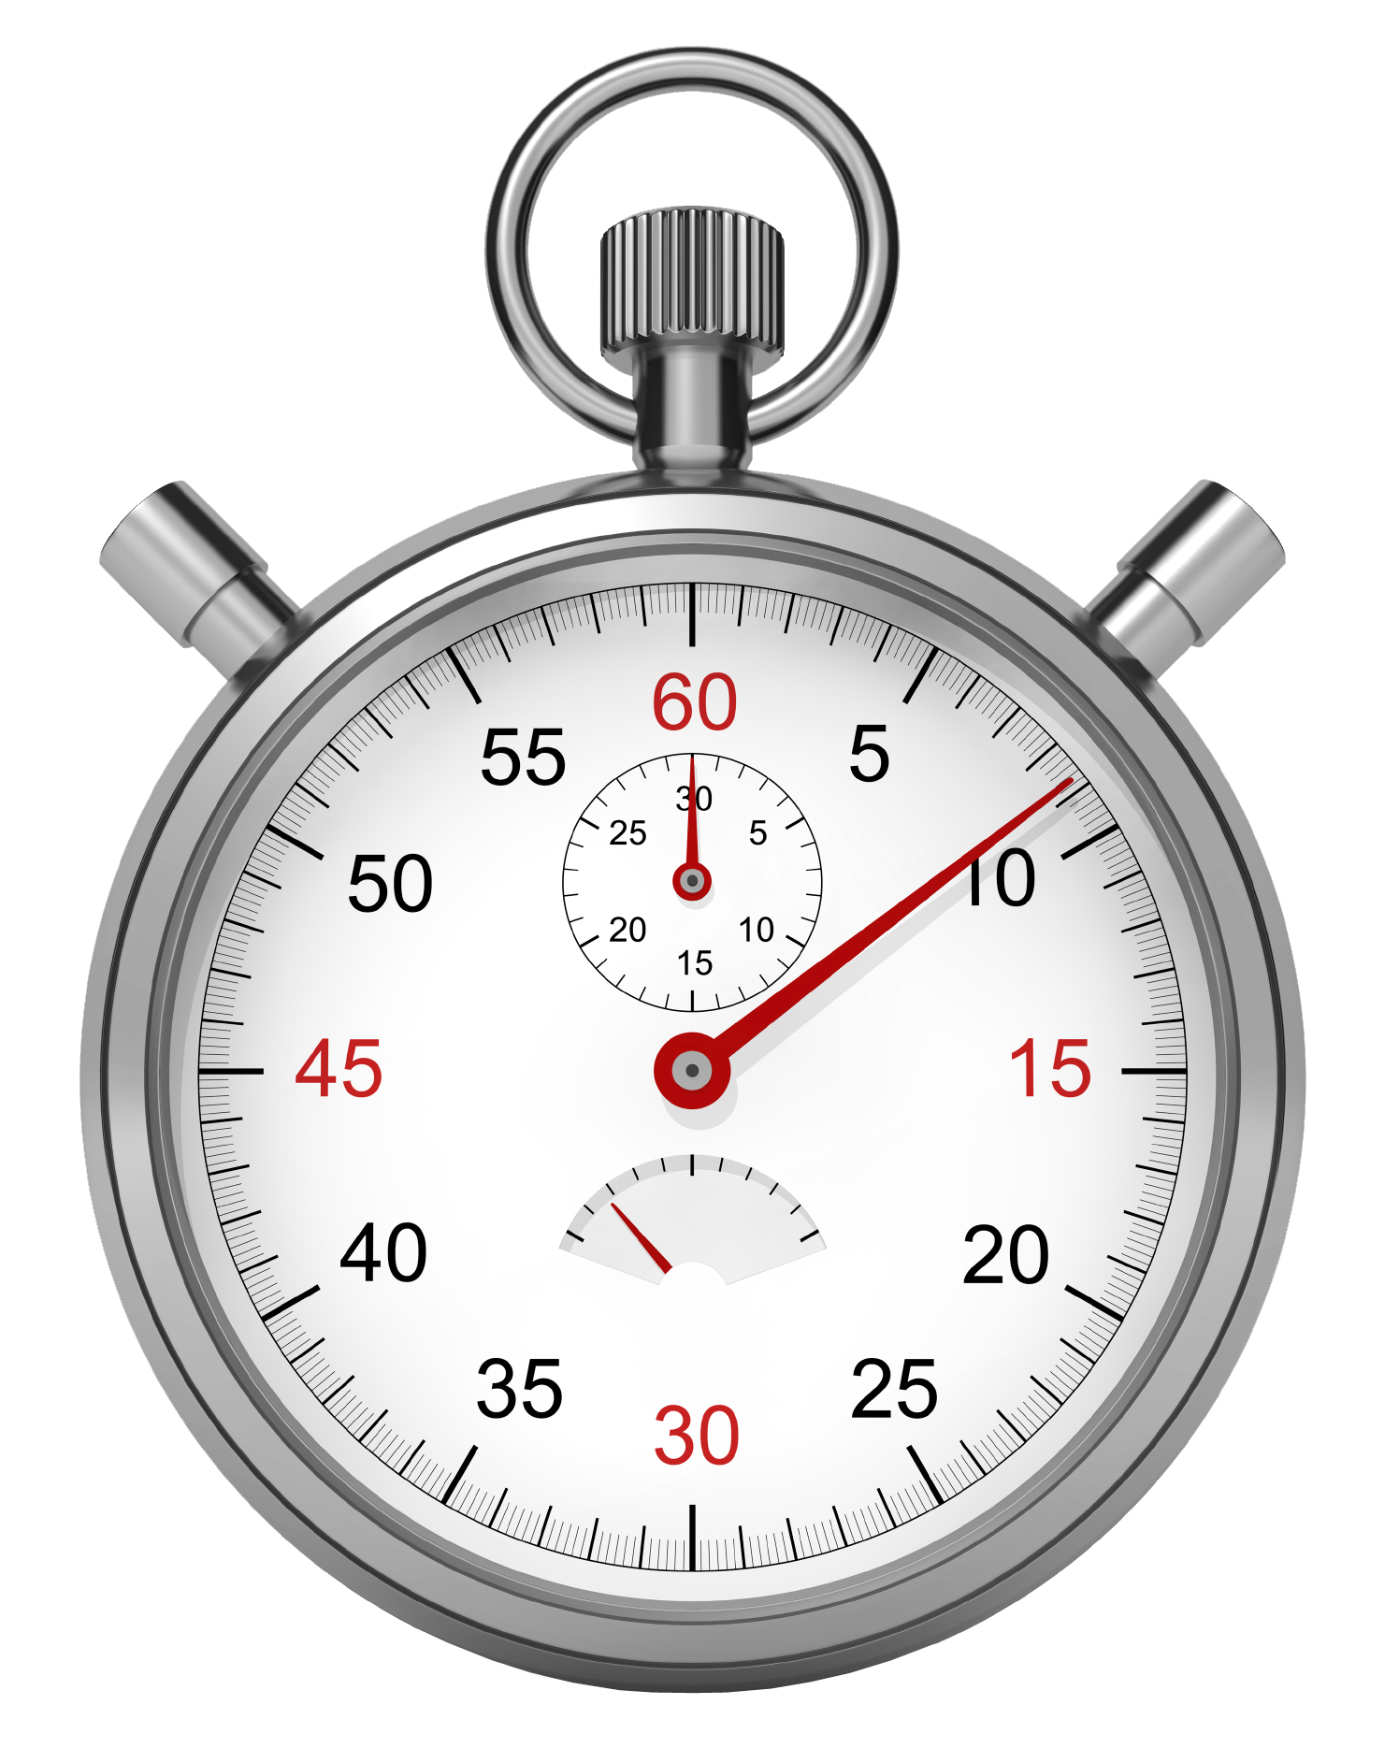
Dev or Ops?
6 Days after a successful deployment, the server experiences high load.
Notes:
Memory leak that took it’s toll after 6 days

Slide 4
Dev or Ops?
There is an issue with the build server.
Code isn’t building.
Notes:
Nothing changed in code, none in Build Server so where is the issue.
Use Case: For a client a third party library dependency was changed from the third party and since on build server that was getting downloaded every time it was causing the issue

Slide 5
Dev or Ops?
Software is deployed to the test environment.
You can’t login to the application.
Notes:
There is only one bug in the system :)

Slide 6
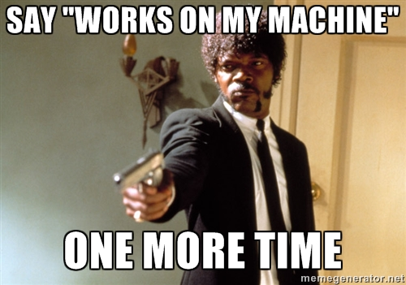
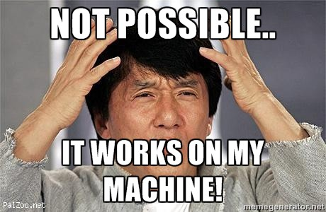
Notes:
Reactions from Dev & Ops

Slide 7
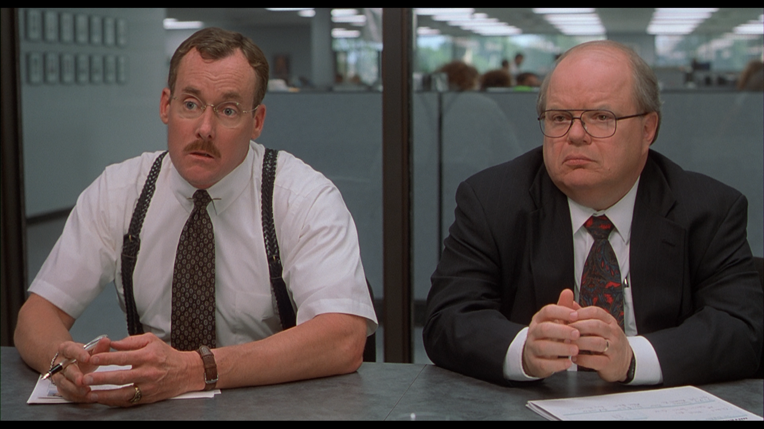
What is the role of Dev and Ops?
Notes:
Sit together and find solution

Slide 8
What are the roles of Devs and Ops?
Dev
Create change
Add or modify features
Ops
Create stability
Create or enhance services

Slide 9
What are the roles of Devs and Ops?
Dev
Create change
Add or modify features
Ops
Create stability
Create or enhance services
Notes:
Change and stability are not the real roles

Slide 10
The Problem
Disconnect between the groups
Results in conflict and inefficiencies
Devs don’t deploy consistent software
Ops are motivated to resist change
Development process is Agile
Operations process is Static
Notes:
Problem is engrained into us
Development-centric folks tend to come from a mindset where change is the thing that they are paid to accomplish. The business depends on them to respond to changing needs. Because of this relationship, they are often incentivized to create as much change as possible.
Operations folks tend to come from a mindset where change is the enemy. The business depends on them to keep the lights on and deliver the services that make the business money today. Operations is motivated to resist change as it undermines stability and reliability. How many times have we heard the statistic that 80% of all downtime is due to those self-inflicted wounds known as changes?
as it undermines stability and reliability - Ops are keeping them from delivering
Change
Culture

Slide 11

And we are missing the point of it all...

Slide 12
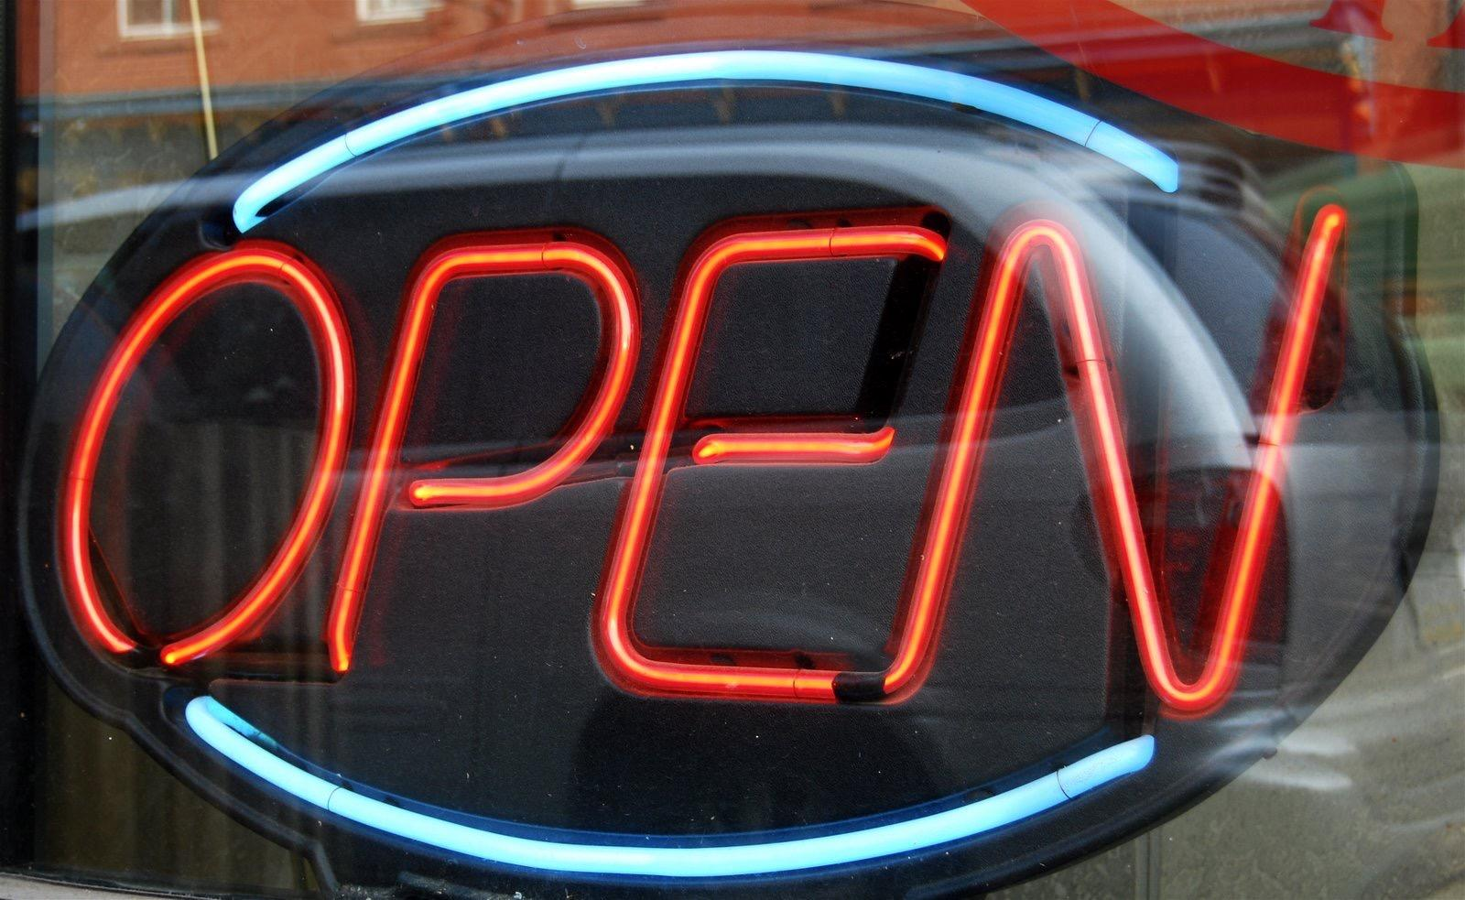
We are all here to ENABLE business

Slide 13
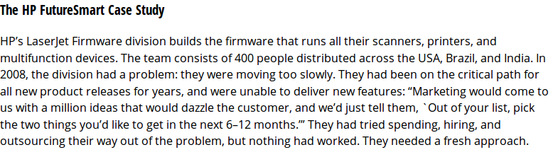
Enabling Business
Notes:
Single Firmware No CI/CD in place
Goals
Create a single platform to support all devices
Increase quality and reduce the amount of stabilization required prior to release
Reduce the amount of time spent on planning
How
The practice of continuous integration
Significant investment in test automation
Creating a hardware simulator so that tests could be run on a virtual platform
Reproduction of test failures on developer workstations
Economic Benefits of HP FutureSmart’s Agile Transformation
Overall development costs were reduced by ~40%.
Programs under development increased by ~140%.
Development costs per program went down 78%.
Resources driving innovation increased eightfold.
CI/CD
http://www.slideshare.net/Mansilladev/modern-tools-for-api-testing-debugging-and-monitoring
https://continuousdelivery.com/evidence-case-studies/
Personal Case Studies:(Can start with how they are doing these things at there end)
Feature Based Development
Code freeze activity: Though Code Freeze was in place but how it was not being followed and what’s the end result after the solution
Making tech an enabler I.e people should have access to deploy code dev on dev env, QA on QA env.

Slide 14
Enabling Business
Notes:
Need to add case study for cloud
SCM
https://puppet.com/resources/case-study/nyse-and-ice
Personal Case Studies:(Can start with how they are doing these things at there end)
On demand infra provisioning along with desired release i.e selecting software's, components and application along with versions
How scm helped in infra setup from a week activity to minutes activity: Classic example how it was done earlier
How much time to setup a prod grade application rentitbae, beato, 4dxfitness: talk about tech stack

Slide 15
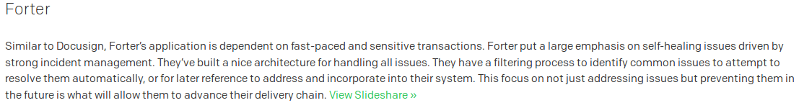
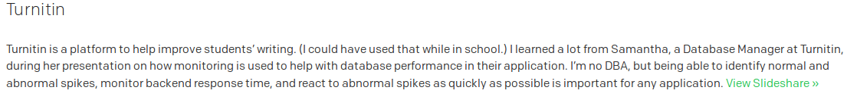
Enabling Business
Notes:
Monitoring
http://www.slideshare.net/itaif/monitoring-patterns-for-mitigating-technical-risk
http://www.slideshare.net/mzsamantha/lag-48410758
Self healing
Monitoring of next level where auto healing bigparser spark setup
User action tracking via elk where we built a dashboard to view all system level operation performed by a use
Deriving Functionality using Monitoring
Monitoring to improve application I.e fliplearn where we are evaluating page load across various network I.e 2g 3g 4g
In Mettl where we used to figure out which browsers needs to be deprecated

Slide 16
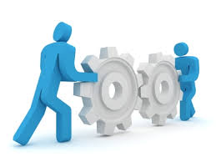
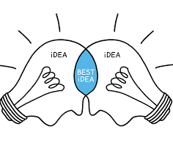

DevOps
Methods For Improving
Communication
Integration
Collaboration
Between Dev & Ops
Notes:
Draw conclusion from above slides that devops is not just only a set of tools or a defined practice it’s more about communication, integration & collaboration across all the roles of team to enable the business

Slide 17
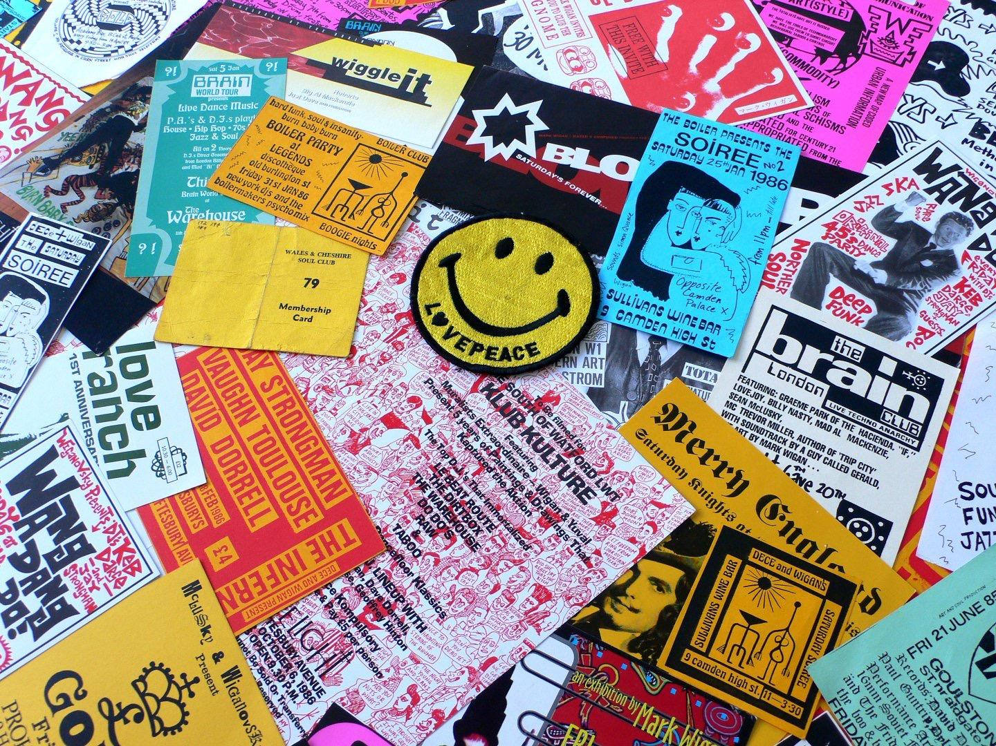
Culture
Notes:
Relationships
Engage early, engage often
Bust Silos TM
Be open
Stop finger pointing
Eradicate “last-mile syndrome”
Communication
Talk is cheap (get out of your chair)
Involve each other in core processes and decisions
Ask Questions
Don’t say “no”
Invite everyone to standups and retrospectives

Slide 18
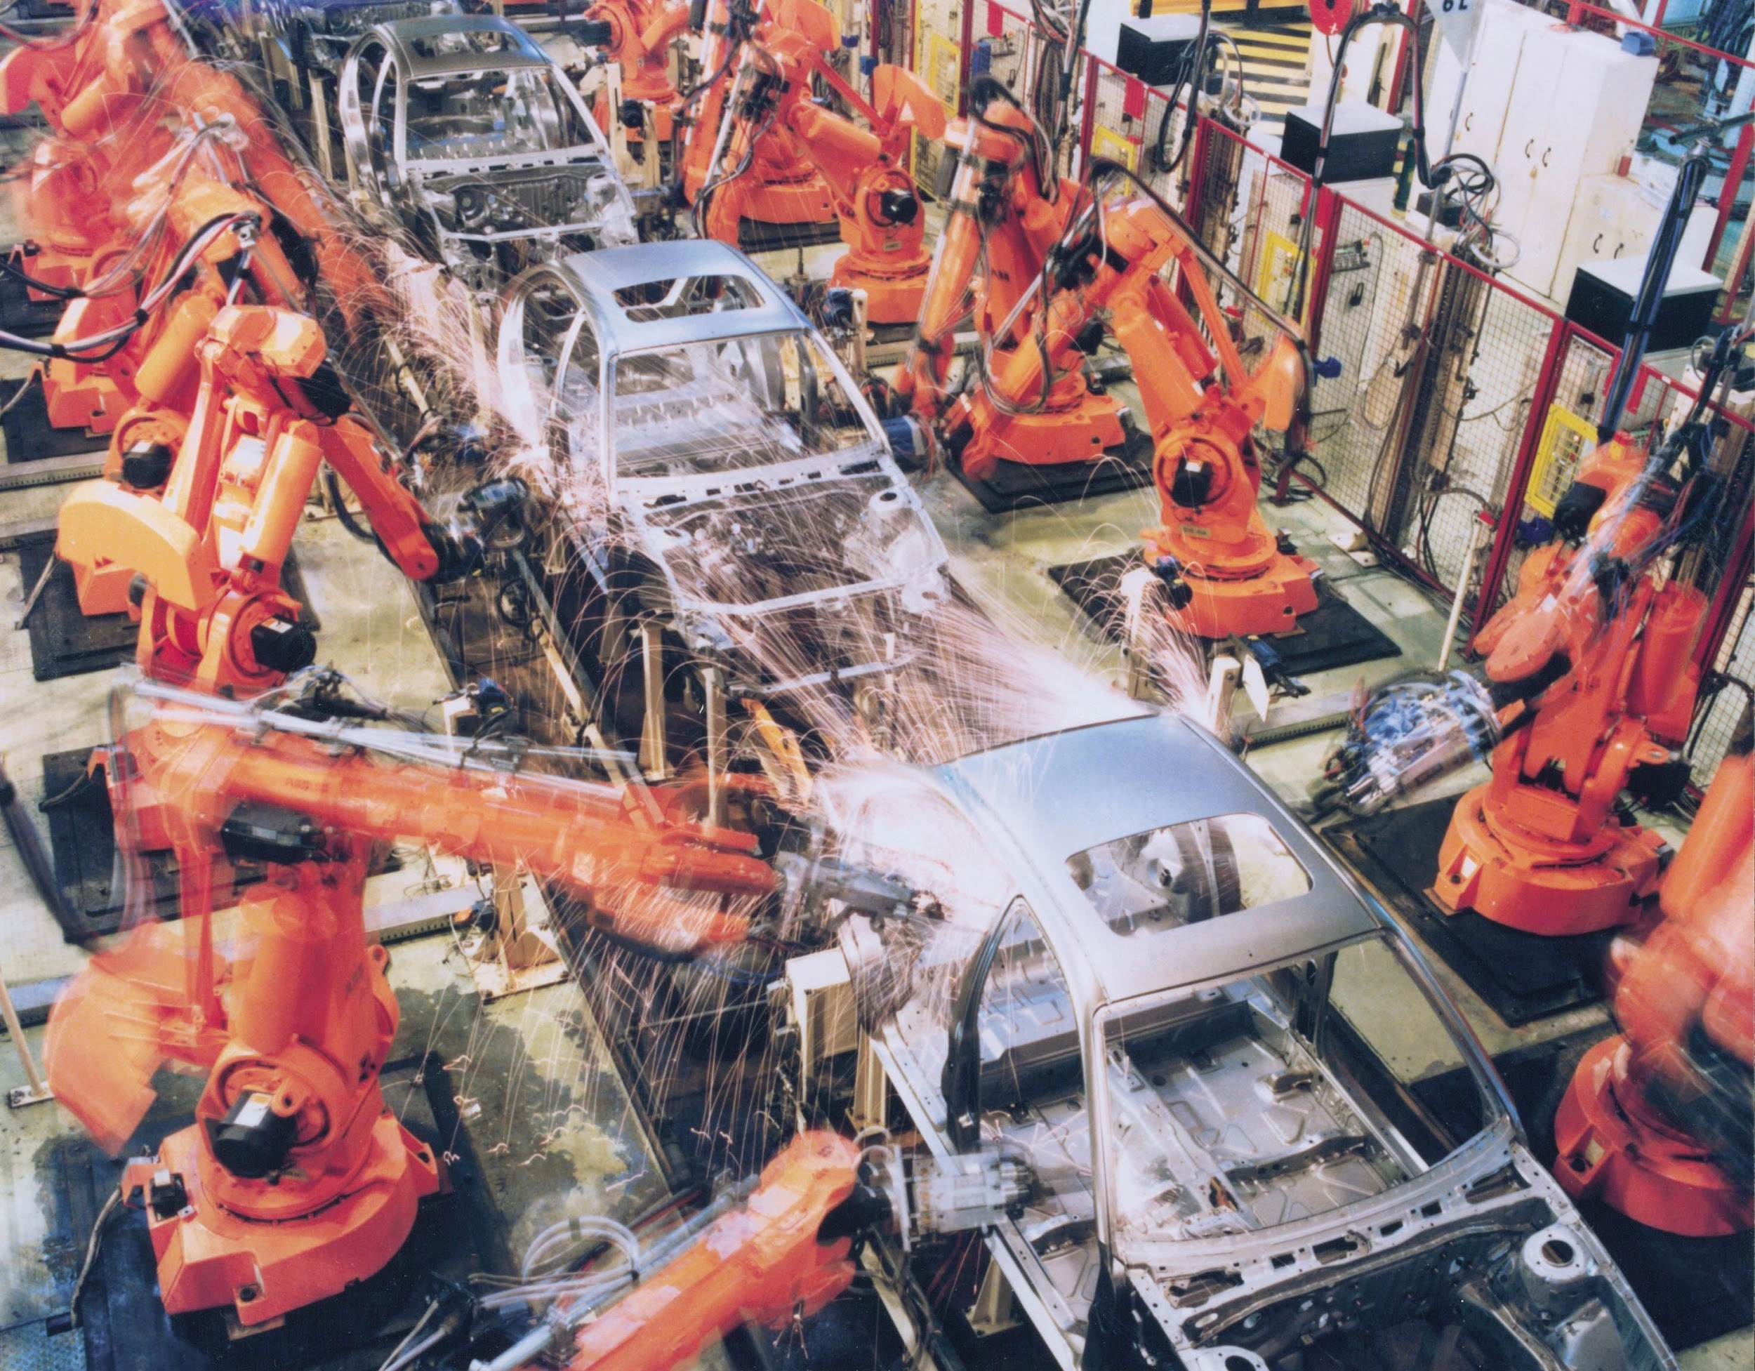
Automation
Notes:
Talk about SD case study where on joining I took a break of 1 week before starting my Build & Release work and implemented very basic CI/CD which was automated thus giving me time to focus on automation instead of getting stuck in the vicious cycle of doing daily multiple releases
AKA less human error
16mins/day over 30 people = 250days/year
What can be automated?
Builds
Deployments
Testings
Monitoring
Self-healing
System rollouts
System configuration
Machines are really good at doing the same task over and over
Consistent and Known State
Fast and Efficient
5 mins/day = 2.6 days/year

Slide 19
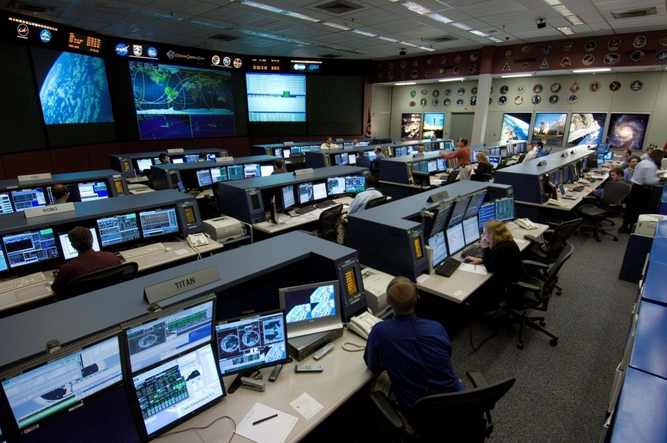
Metrics
Notes:
Discuss with audience what all comes under metrices
CI/CD metrices
App log metrices
App level metrices
Infrastructure level metrices
Or any other metrices that will vary from company to company or team to team

Slide 20

Sharing
Notes:
Share Ideas
Share Metrics
Ops: Give devs shell access
Devs: See what technology can be leveraged

Slide 21

DevOps Lifecycle
Notes:
Continuously Evolving
Use Case?

Slide 22
Before
Talk about functional requirements
Talk about non-functional requirements
Security
Backups
Availability
Upgradeability
Configuration Mgmt
Monitoring
Logging
Metrics
Notes:
Talk about product backlocking, Sprint Planning or Project Kick off. Take example of 4dx where we had all our initial discussion had infra diagram ready before hand, already know what all softwares which one needed POC. Strategies in place for each and everything

Slide 23
During
Communication
Source Control
Automate Builds
Automate Tests
Automate Deployments (Dev, Test and Prod)
Collate App and System Metrics
Notes:
Actual implementation, adding values from day 1, i.e building CI/CD, Dev setups helped in creating prod/non-prod environments more effectively

Slide 24
After
Release
Retrospective Meetings
Continue to Run Tests
Monitor Applications and Systems
Issues (Yes, they do happen)
Post Mortem Meetings
Notes:
How daily, weekly & monthly reporting helped us in fine tuning the infrastructure and reducing the costs
Howmanaging all the production issues in runbooks and tracking them via tracker increased the productivity of team(most importantly follwing the moto of Continuous Automation)

Slide 25
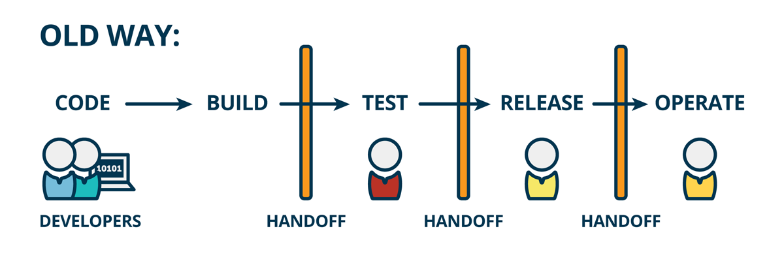
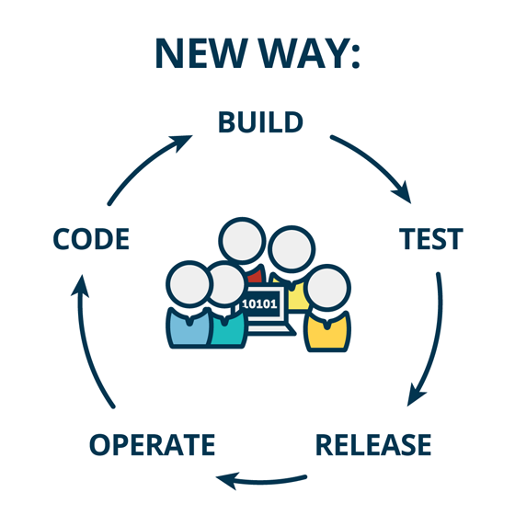
Old Way : Without DevOps New Way : With DevOps
Notes:
Waterfall & Agile
Quick case studies

Slide 26
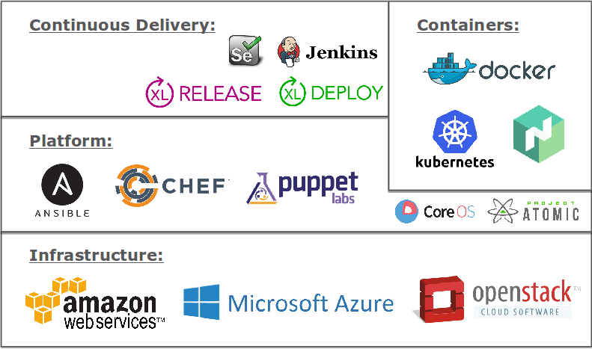
Areas where DevOps is involved
Notes:
VCS
SCM
CI/CD
Cloud(Containerization)
Monitoring

Slide 27

Questions ?

